Slide 1




Studio Shodwe
Home
Service
About Us
Contact
KALVIUM
ASSIGNMENT

Slide 2

Home
Service
About Us
Contact
given website is
https://results.eci.gov.in/PcResultGenJune2024/index.htm
data was scraped using
BeautifulSoup
Requests

Slide 3
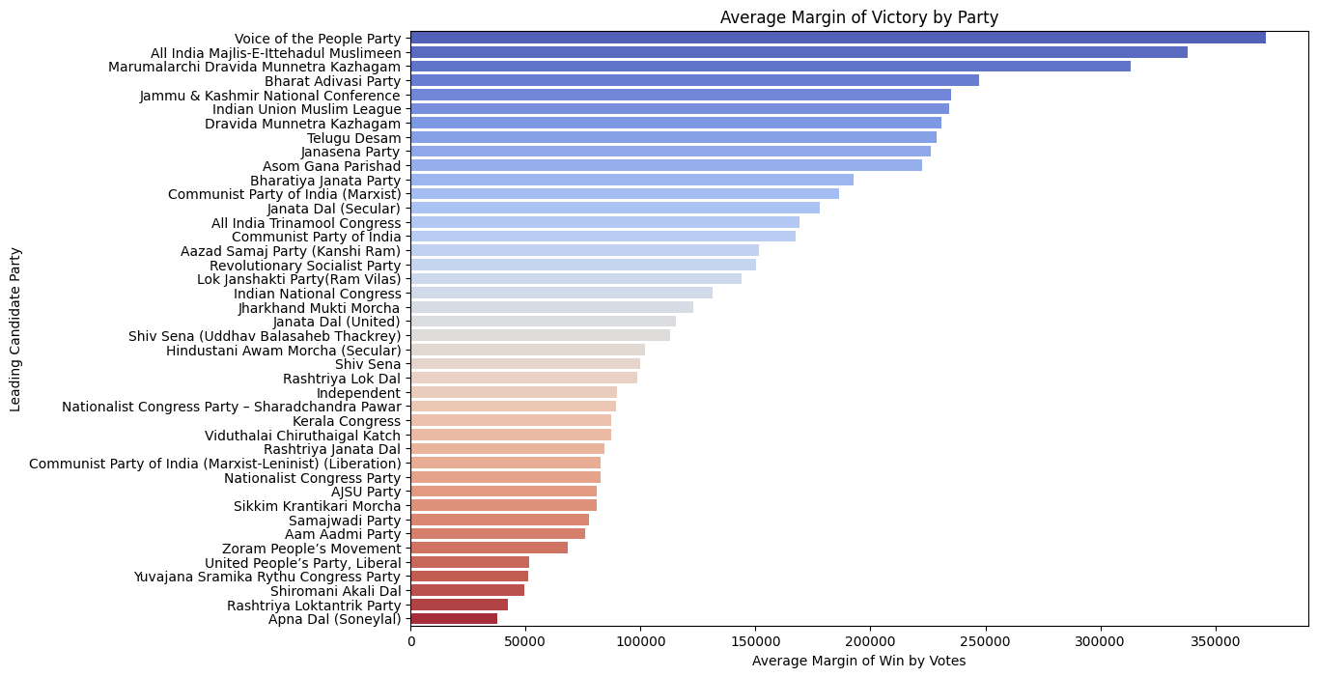
insights

Slide 4
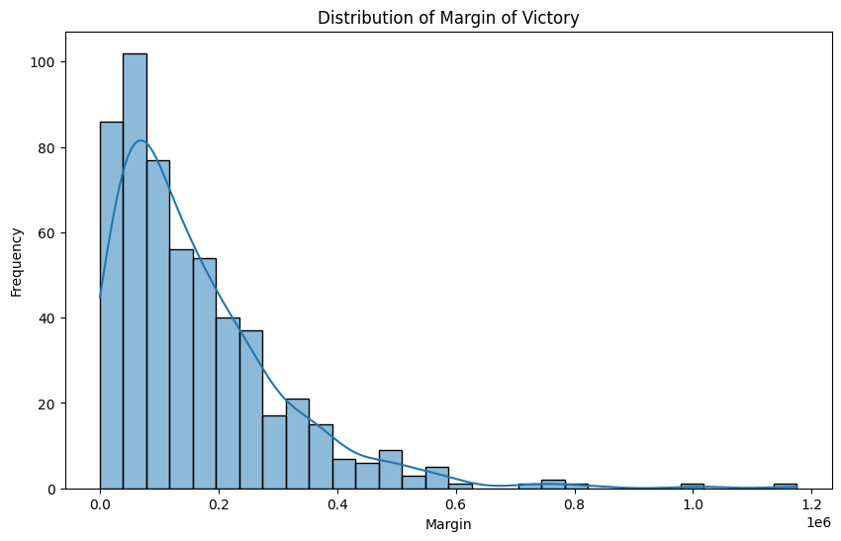
insights

Slide 5
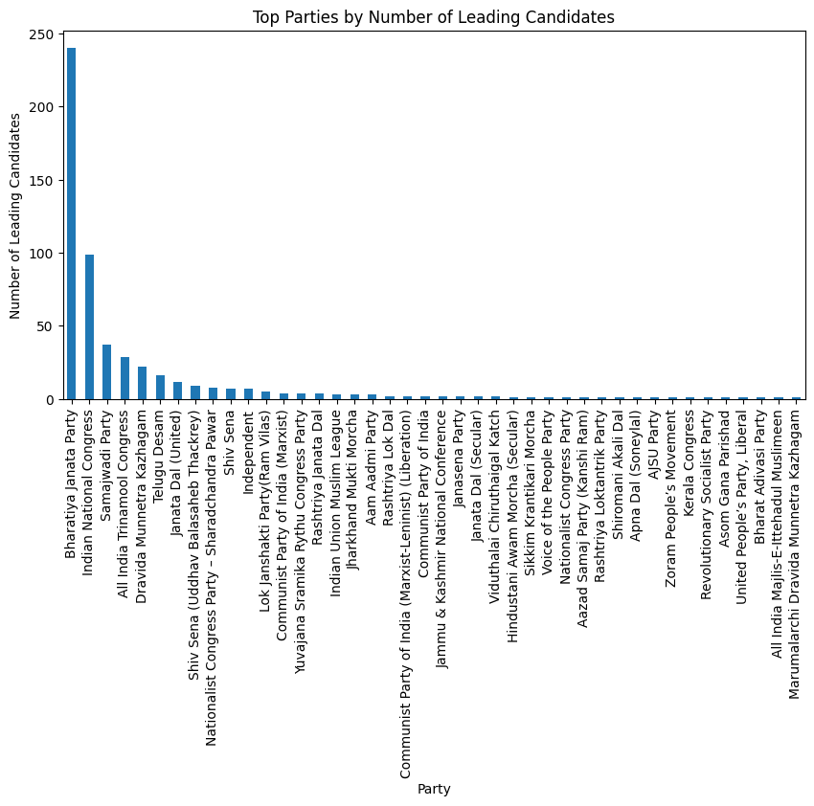
insights

Slide 6
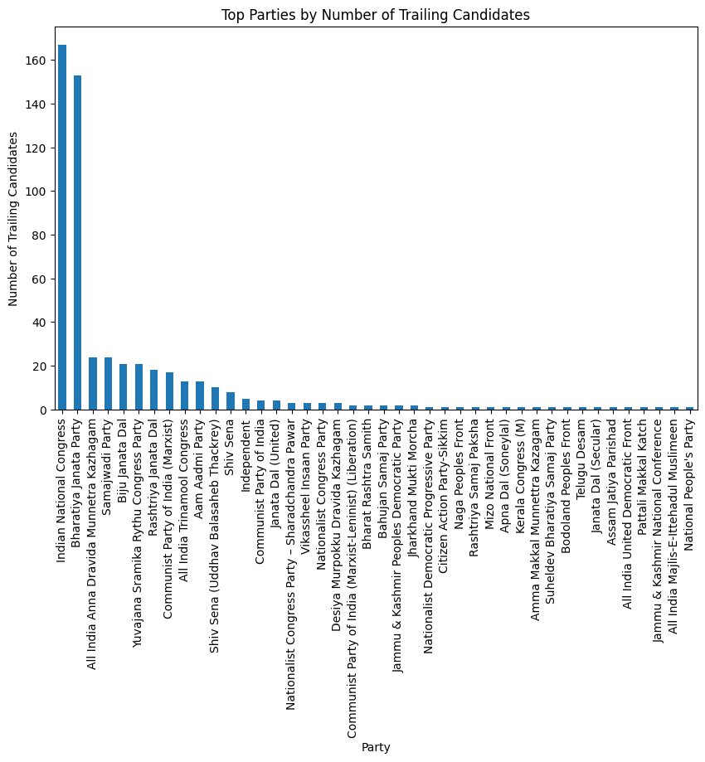
insights

Slide 7
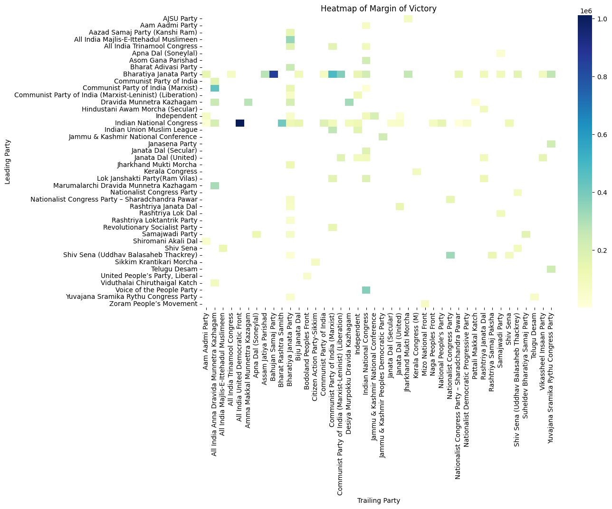
insights

Slide 8
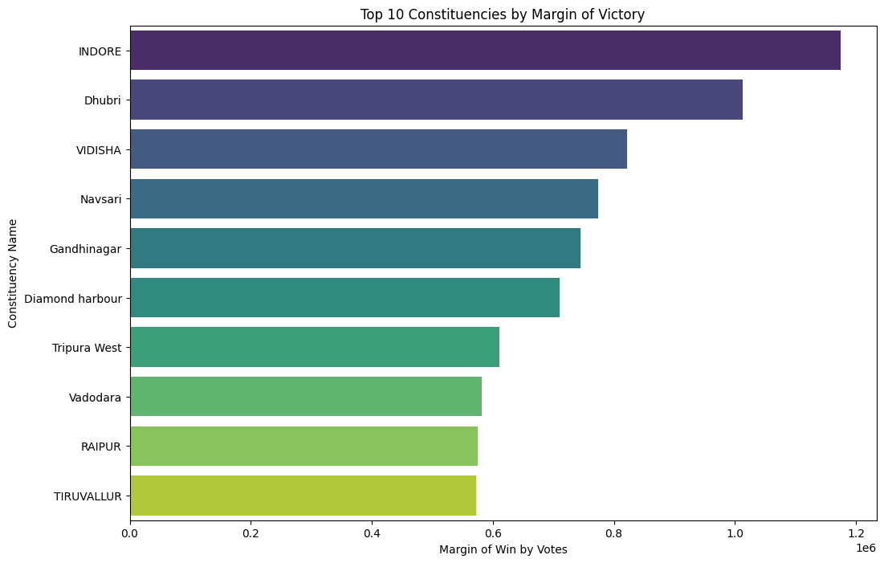
insights

Slide 9
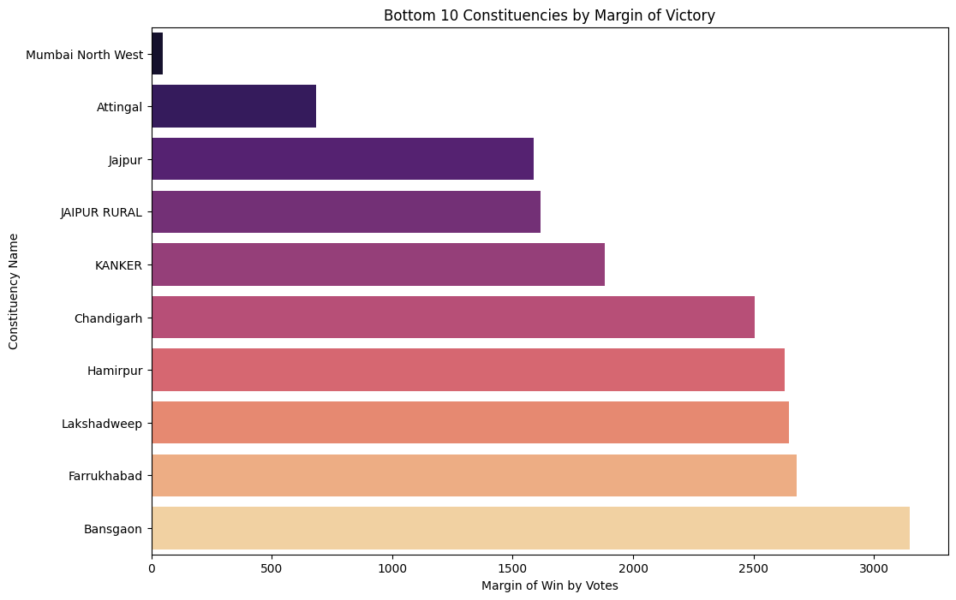
insights

Slide 10
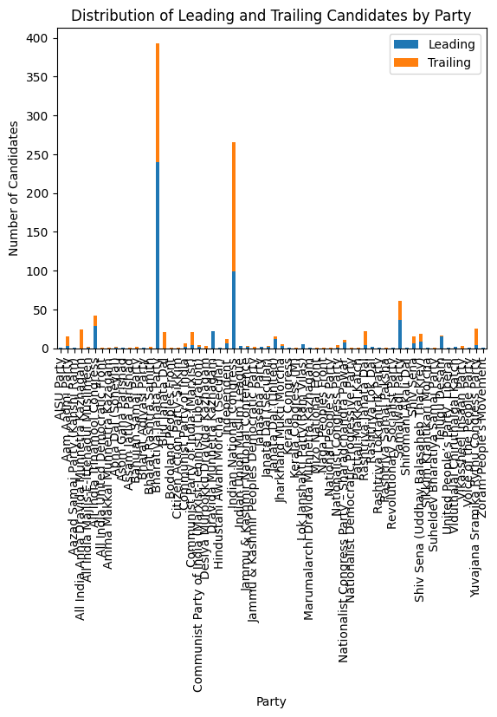
insights

Slide 11
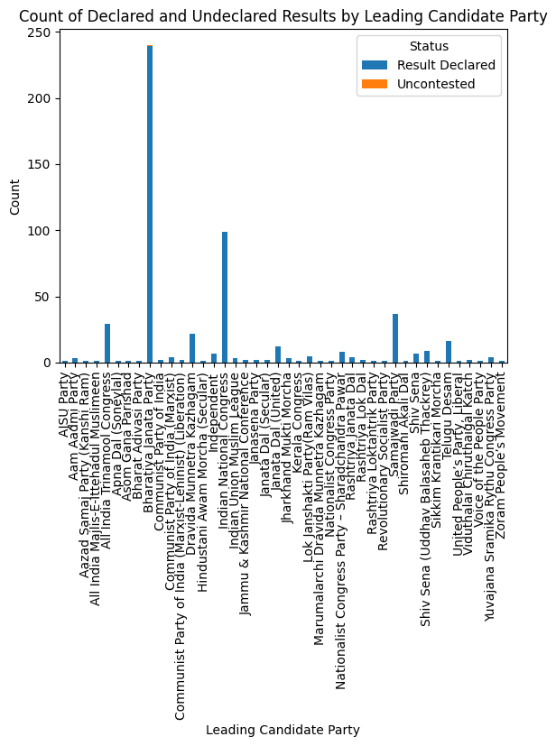
insights

Slide 12
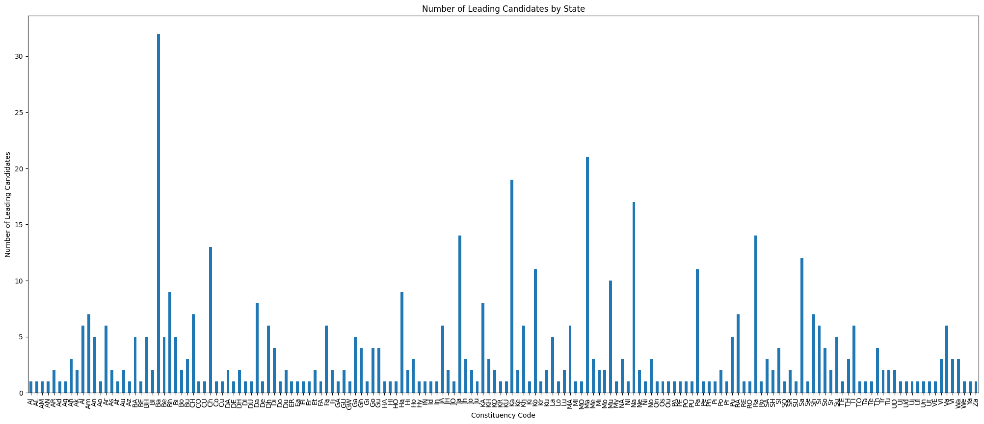
insights

Slide 13
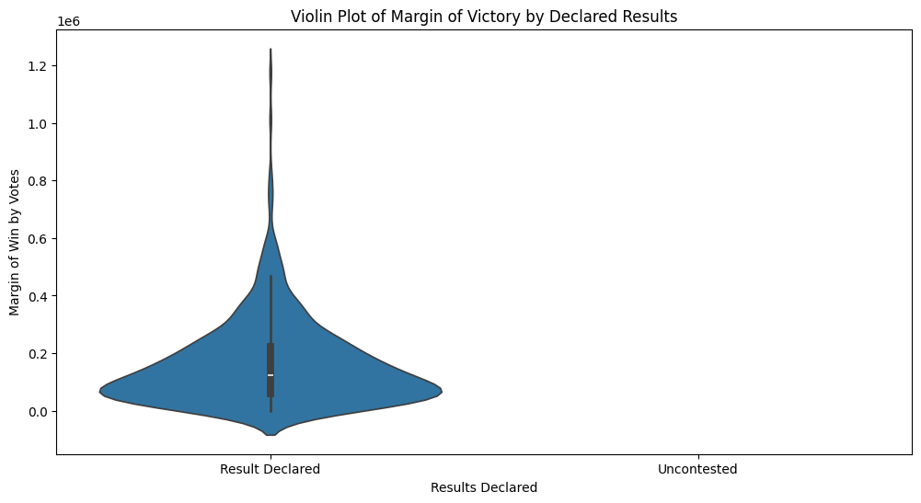
insights

Slide 14
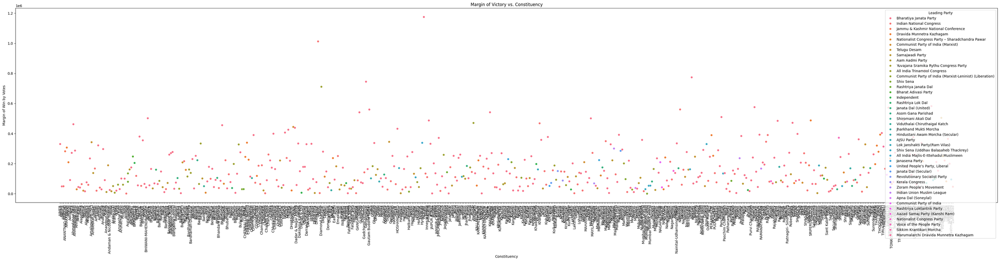
insights

Slide 15
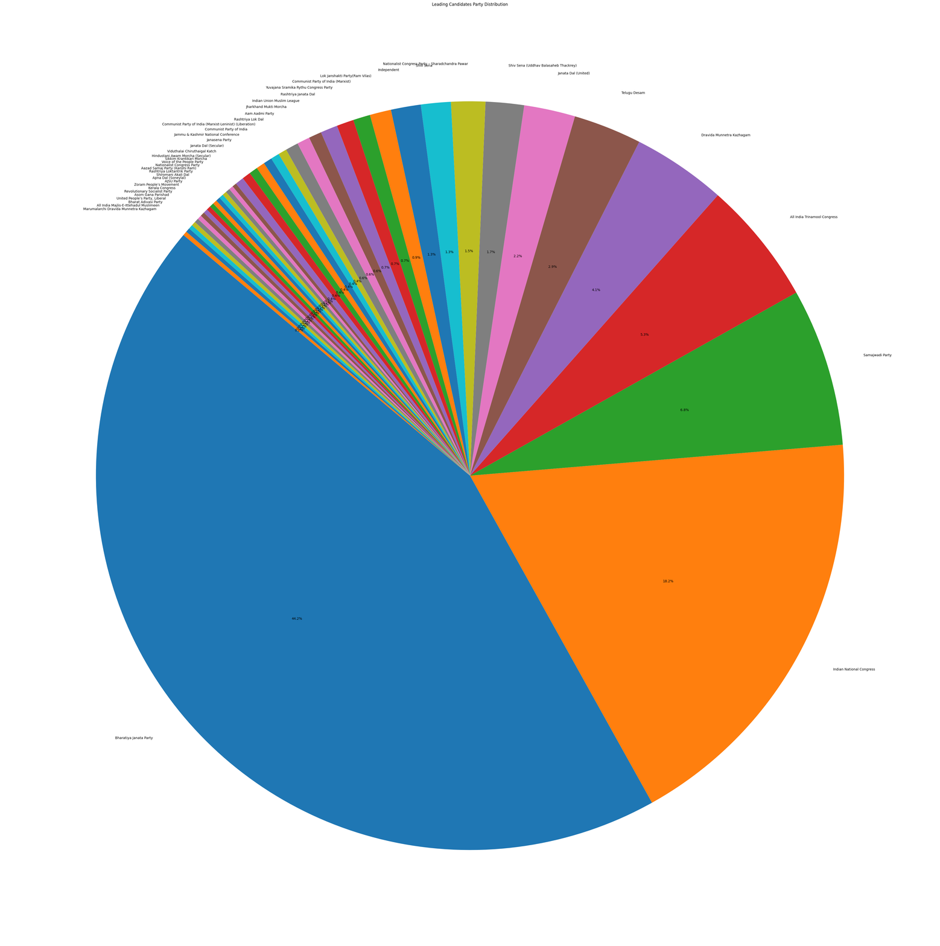
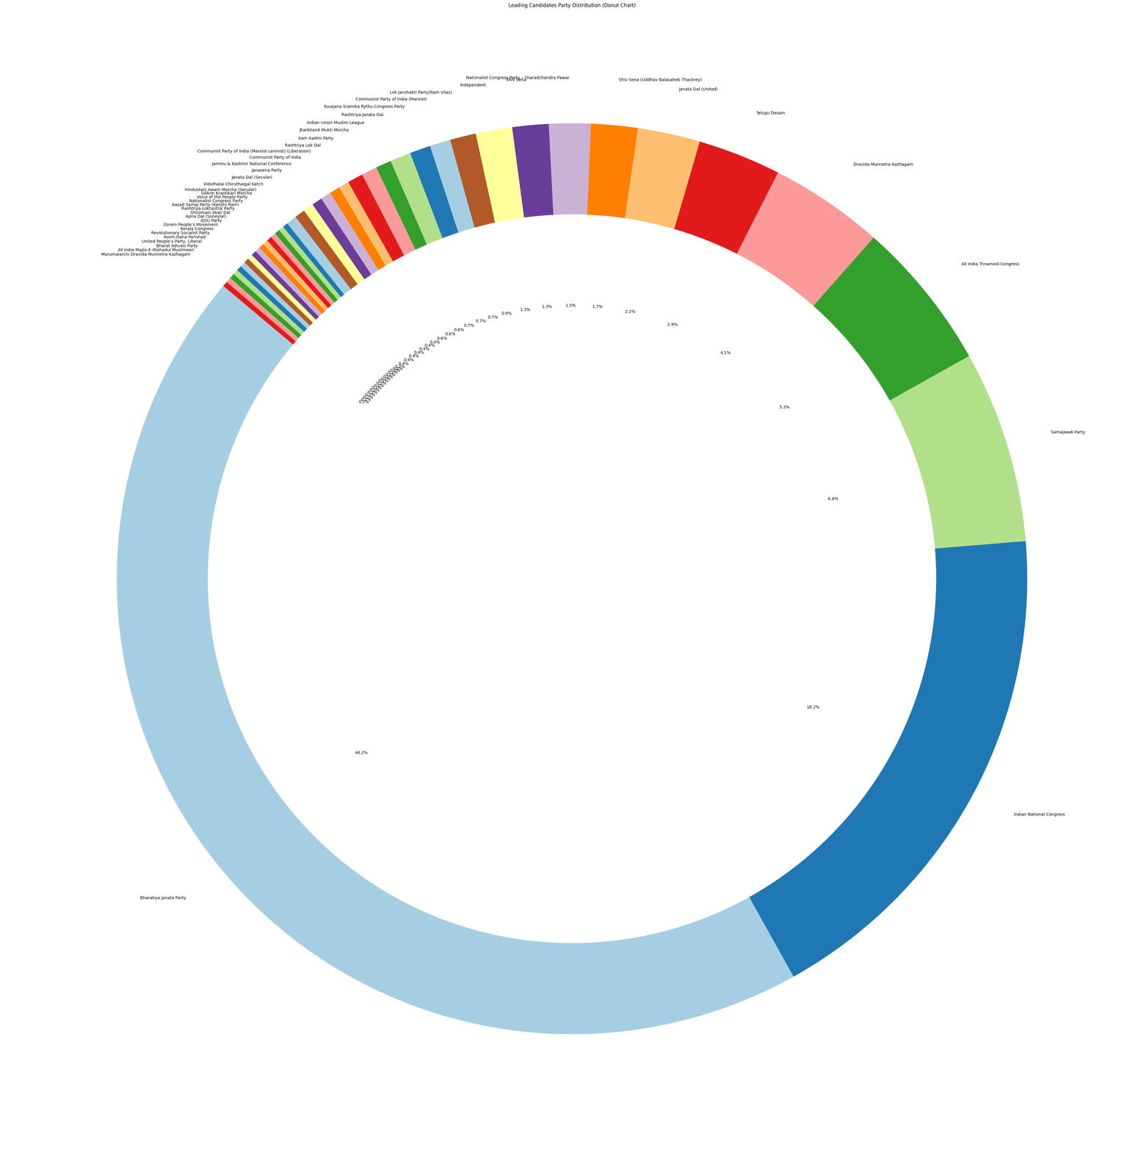
insights

Slide 16
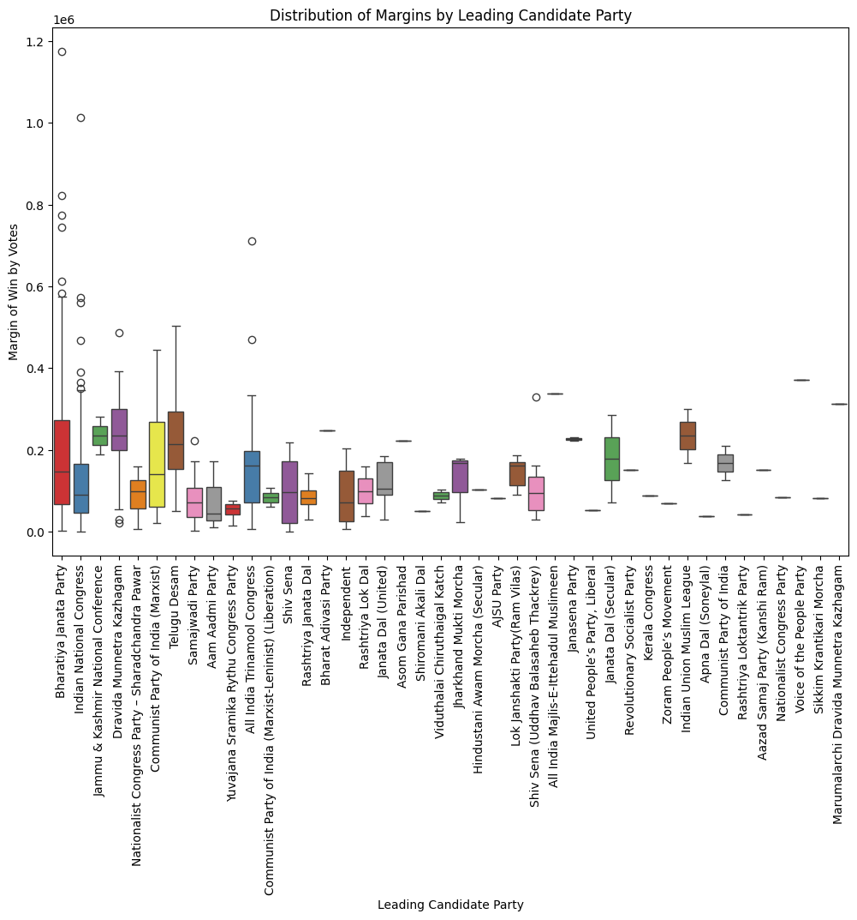
insights

Slide 17
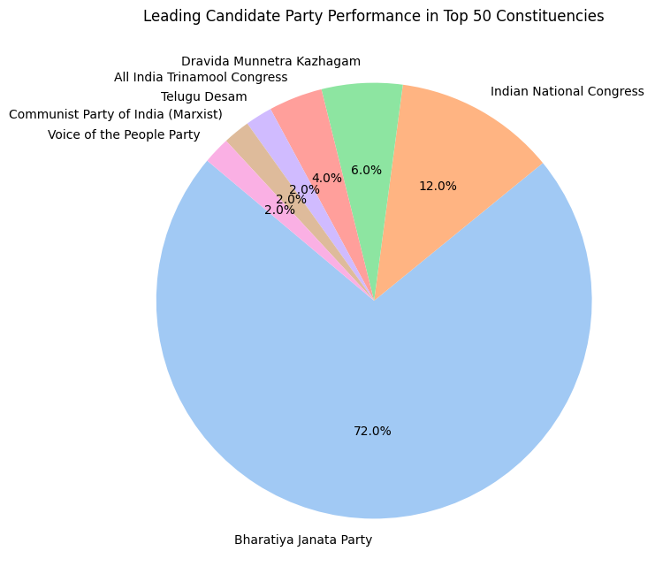
insights

Slide 18
Thank you....

